Slide 1
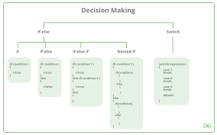
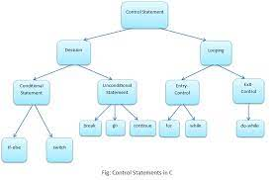
Decision Control Statements

Slide 2

WHAT ARE DECISION CONTROL STATEMENTS?
The decision control statements are the decision making statements that decides the order of execution of statements based on the conditions. In the decision making statements the programmer specify which conditions are to be executed or tested with the statements to be executed if the condition is true or false.

Slide 3
Types Of Decision Control Statements
IF STATEMENT-The if statement consists a condition which is followed by one or some of the statements, if the condition is true then the statements will be executed or else not. This statement is the simple and easy decision control statement.
IF – ELSE STATEMENT- In the if-else statement the if statement is followed by the else statement which will execute when the expression is false.
SWITCH STATEMENT- The switch statement allows the variable to be tested for equality against a list of values. In the switch statement every value is called case and the variable is switched on is checked for each case.

Slide 4


